Slide 1

Structured data markup for life sciences with Schema.org
25th-26th October 2016
Roberto Preste

Slide 2
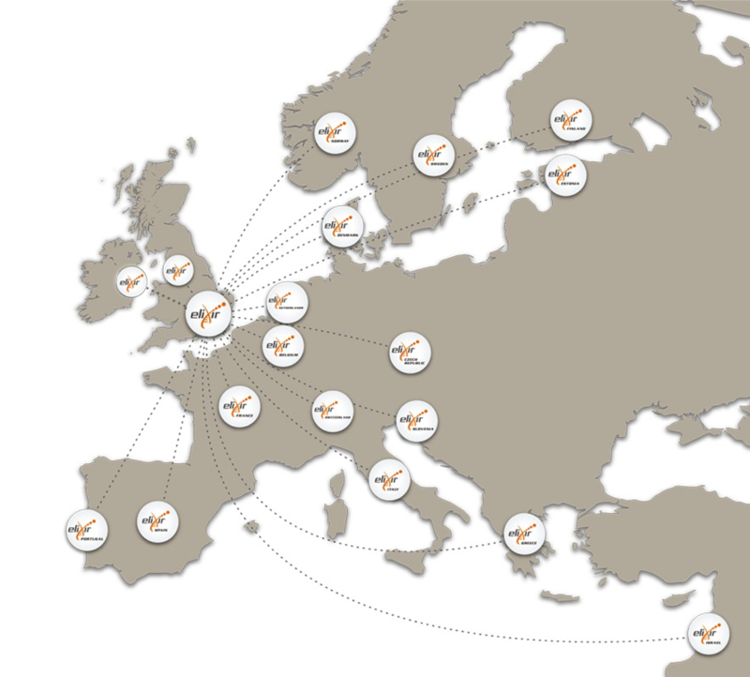












ELIXIR: European infrastructure for biological information
Data infrastructure for Europe’s life-science research:
Data
Interoperability
Tools
Compute
Training
Marine metagenomics
Crop and forest plants
Human data
Rare diseases
www.elixir-europe.org
@ELIXIREurope

Slide 3
Research and information sharing
Information is exposed in the Internet through web pages
Great for common users
Bad for automated and programmatical data collection

Slide 4
Schema.org
Community and collaborative initiative to integrate structured data markup on web pages, email messages and on the Internet in general, without altering the presentation layer

Slide 5
Schema.org
Allows search engines to easily access websites’ content and provide more useful results based on their underlying metadata

Slide 6
Schema.org
Adopted by > 10 million websites
Sponsored by
…but still not this popular in the life science community!

Slide 7
Bioschemas
Bioschemas aims to apply the Schema.org markup in life science
Better discoverability and usability of structured data

Slide 8
Bioschemas: organization
Open community initiative:
Organized in groups:

Slide 9
Bioschemas: specifications
Content types
Generic content types
Biological content types
E.g.: training materials, datasets
E.g.: pathways, proteins
Can be used in many disciplines, besides life science
Are domain-specific
In collaboration with
to integrate and extend
Schema.org types and properties

Slide 10
Bioschemas: specifications
Introduction
Data model
Content guidelines
Cardinality and controlled vocabularies
New properties
Examples
Overview of the problem, goal of the specification, technologies used to implement the solution

Slide 11
Bioschemas: specifications
Introduction
Data model
Content guidelines
Cardinality and controlled vocabularies
New properties
Examples
Describes how to elaborate and implement more specific guidelines into a Schema.org skeleton

Slide 12
Bioschemas: specifications
Introduction
Data model
Content guidelines
Cardinality and controlled vocabularies
New properties
Examples
Defines a set of Minimum fields that are mandatory, Recommended fields for optimal discovery and integration, and Optional fields to enhance the user experience

Slide 13
Bioschemas: specifications
Introduction
Data model
Content guidelines
Cardinality and controlled vocabularies
New properties
Examples
Define the number of times a property can be instantiated and specific terms that need to be used

Slide 14
Bioschemas: specifications
Introduction
Data model
Content guidelines
Cardinality and controlled vocabularies
New properties
Examples
New properties can be suggested in order to provide more accurate and useful type description in life science

Slide 15
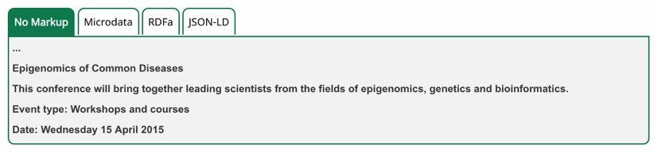
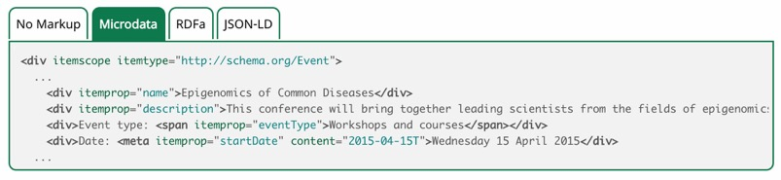
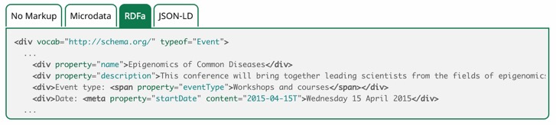
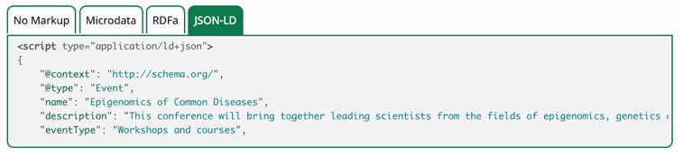
Bioschemas: specifications
Introduction
Data model
Content guidelines
Cardinality and controlled vocabularies
New properties
Examples

Slide 16

Bioschemas: applications
Improving search results via Bioschemas
PDBe, UniProt, Pfam, …
Data
repository
Data
repository
Data
repository
Bioschemas
Bioschemas
Bioschemas
Registry
Search engine
Biosharing,
Biosamples, Identifiers.org,
Bio.tools,
TeSS
UKCRC Tissue Directory …
Google, Yahoo, Bing, Yandex, …
Search engines favour websites containing schema.org in their search results

Slide 17
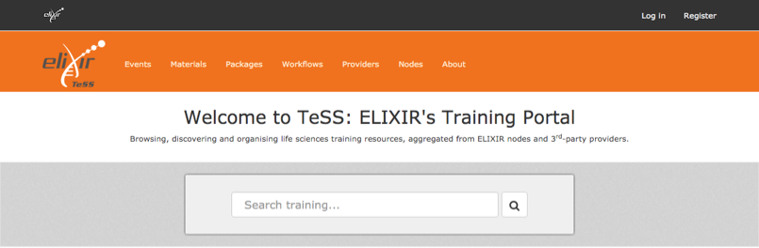








Bioschemas: applications
TeSS: ELIXIR’s Training Portal
https://tess.elixir-uk.org

Slide 18

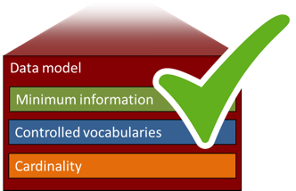

Bioschemas: validation
Discovery, Registration and Validation
DISCOVERY
VALIDATION
Provide a simple registry where providers or consumers can describe of sites providing content in schema.org compliant with Bioschemas
Provide a GUI to validate Bioschemas compliant websites and Validate data repositories adopting Bioschemas
Dataset
Sample
Protein

Slide 19

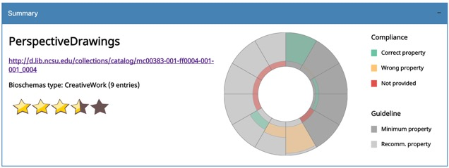
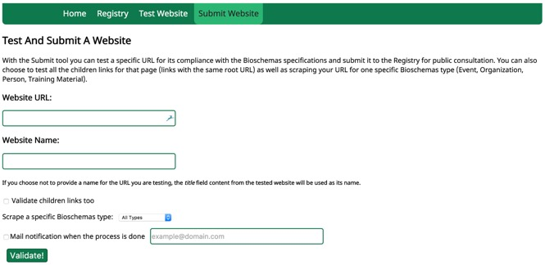
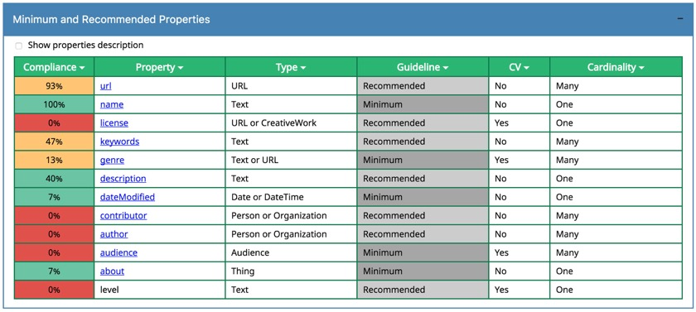
Bioschemas: validation

Slide 20

Implementation Study Objectives
Upcoming activities
Life sciences Content Types
Schema.org content types for life science Data
Data repository, Dataset
Samples, Protein annotations
Phenotype annotations
Hands-on workshops
Small delivery team
Publication of metadata
Automated integration of metadata in specialised registries
Discovery and validation
Discovery and validation of Bioschemas entries
Support community and adoption
Alignment of technical activities
Working group within ELIXIR
Collaboration between ELIXIR and BD2K
Test benefits and issues
Community Support and Promotion

Slide 21
Upcoming activities
Bioschemas AGM, 8th-9th November, Rothamsted (UK)
Details on https://goo.gl/hu7uYK
More content types for life science in development:
Tools
Data repository
Dataset
Sample
Phenotype
Protein annotations

Slide 22
Acknowledgements
Bioschemas community
Group chairs
Community
Premysl Velek
Event
Martin Cook
Training materials
Aleksandra Nenadic & Gabriella Rustici
Organization
Richard Holland & Rafael C Jimenez
Person
Niall Beard
Standard
A Gonzalez-Beltran & P McQuilton
Organization representatives
BBMRI
Michaela Mayrhofer
TeSS
Niall Beard
BioSharing
SA Sansone, A Gonzalez-Beltran, P McQuilton, P Rocca-Serra
NIH BD2K bioCADDIE
SA Sansone, A Gonzalez-Beltran, Jeff Grethe
ELIXIR
Premysl Velek
Pistoia Alliance
Richard Holland
GOBLET
Terry Atwood

Slide 23
Contributors
Aleksandra Nenadic
Adam Hospital
Gabriella Rustici
Carlos Horro
Martin Cook
Niall Beard
Rafael C Jimenez
Andy Jenkinson
Manuel Corpas
Roberto Preste
Richard Holland
Alejandra Gonzalez-Beltran
Andrew Lonie
Carole Goble
Peter McQuilton
Premysl Velek
Ian Dunlop
Jef Grethe
Milo Thurston
Niklas Blomberg
Yasset Perez-Riverol
Sarala Wimalaratne
Nick Juty
Jose Luis Ambite
Brane Leskošek
Celia van Gelder
Christa Janko
Christine Staiger
Dan Brickley
Daniel Faria
Dmitry Repchevsky
Daniel Sobral
Daniel Vaughan
Ian Fore
Frederik Coppens
Josep Gelpi
ChuQiao Gong
Hedi Peterson
Hervé Ménager
Nina Hrtonova
Isabelle Perseil
Jaap Heringa
Jon Ison
John Hancock
Simon Jupp
John D. Van Horn
Ivana Krenkova
Laura Furlong
Morris Swertz
Mateusz Kuzak
Mario Alberich
Mark Thompson
Maria Martin
Mikael Borg
Montserrat Gonzàlez
Norman Morrison
Nùria Queralt-Rosinach
Olivier Sallou
Robert Pergl
Pedro Fernandes
Pierre Larmande
Rob Finn
Renzo Kottmann
Rodrigo Lopez
Sameer Velankar
Sara Light
Carol Shreffler
Silvano Squizzato
Susanna Sansone
Tony Burdett
Terry Atwood
Cath Brooksbank
Luc Deltombe
Michaela Mayrhofer
Philippe Rocca-Serra

Slide 24

Thank you!
all@bioschemas.org
http://bioschemas.org
@BioSchemas

